Slide 1
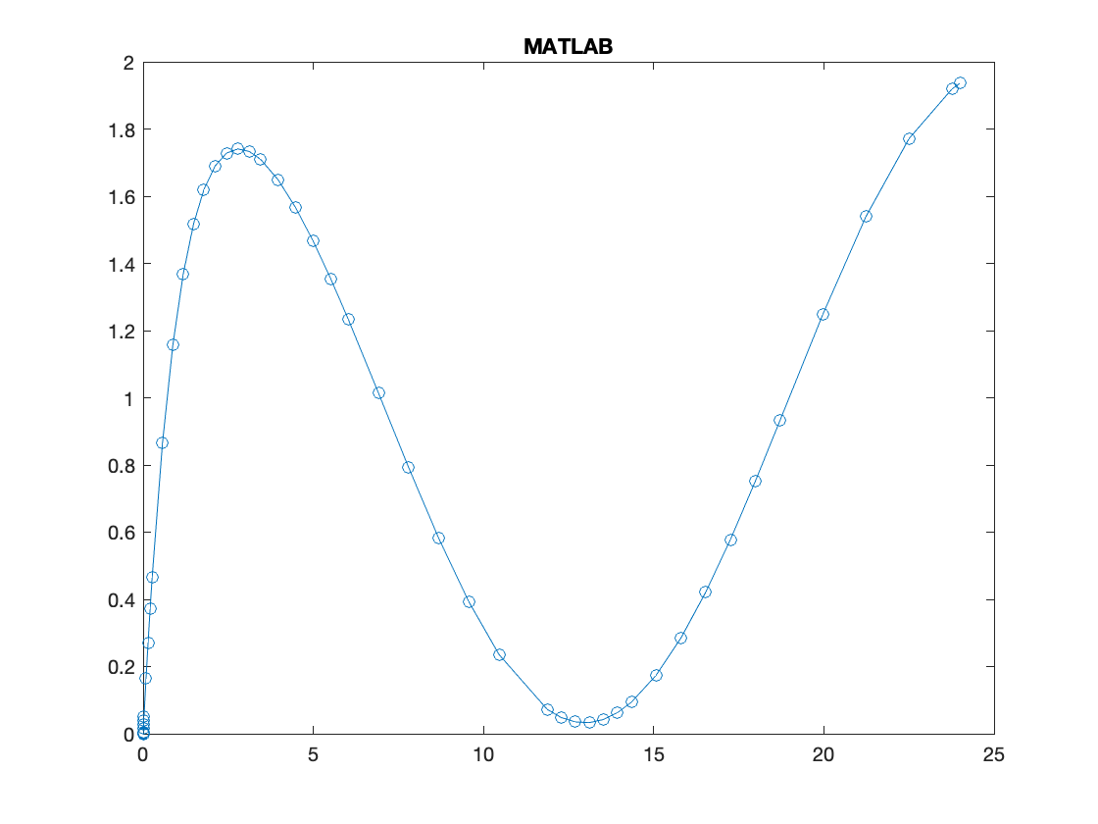
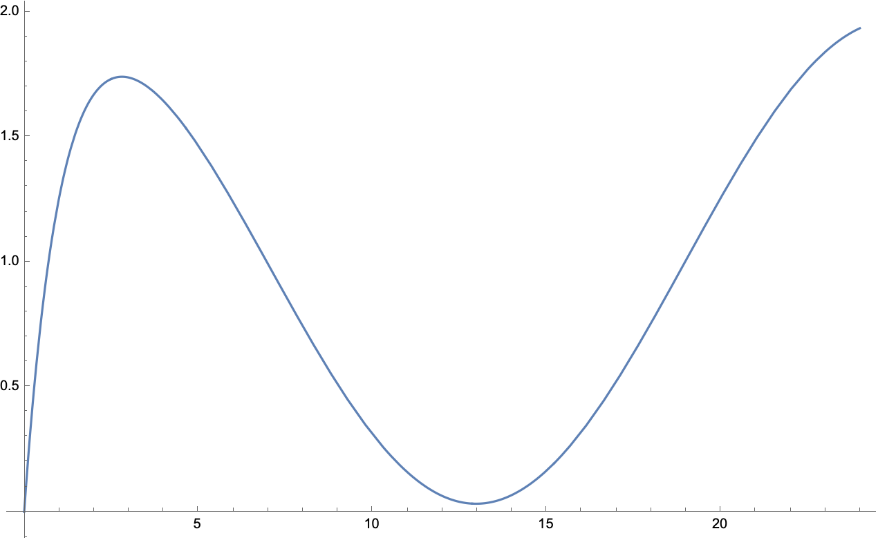
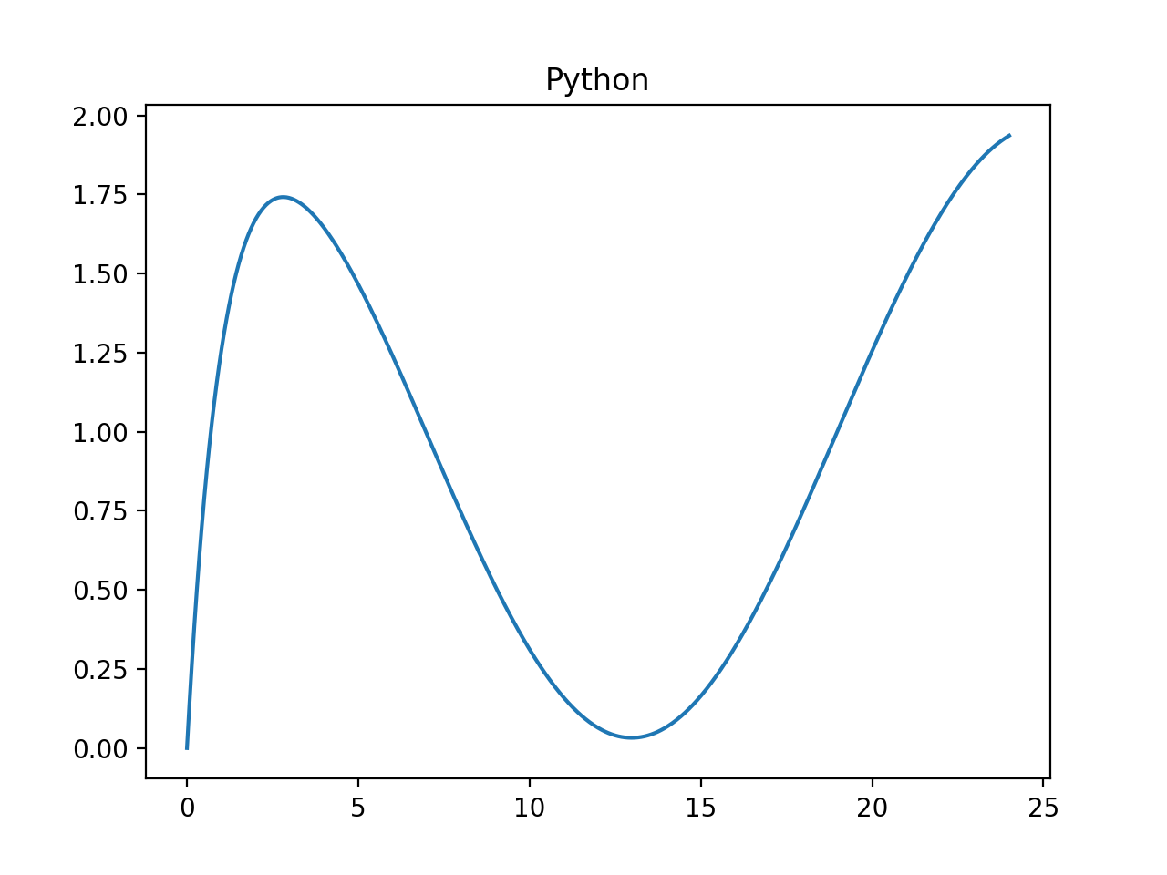
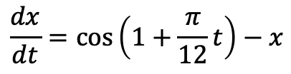
Mathematica
$$\frac{dx}{dt}=\cos\left(1+\frac{π}{12}t\right)−x$$

Slide 2
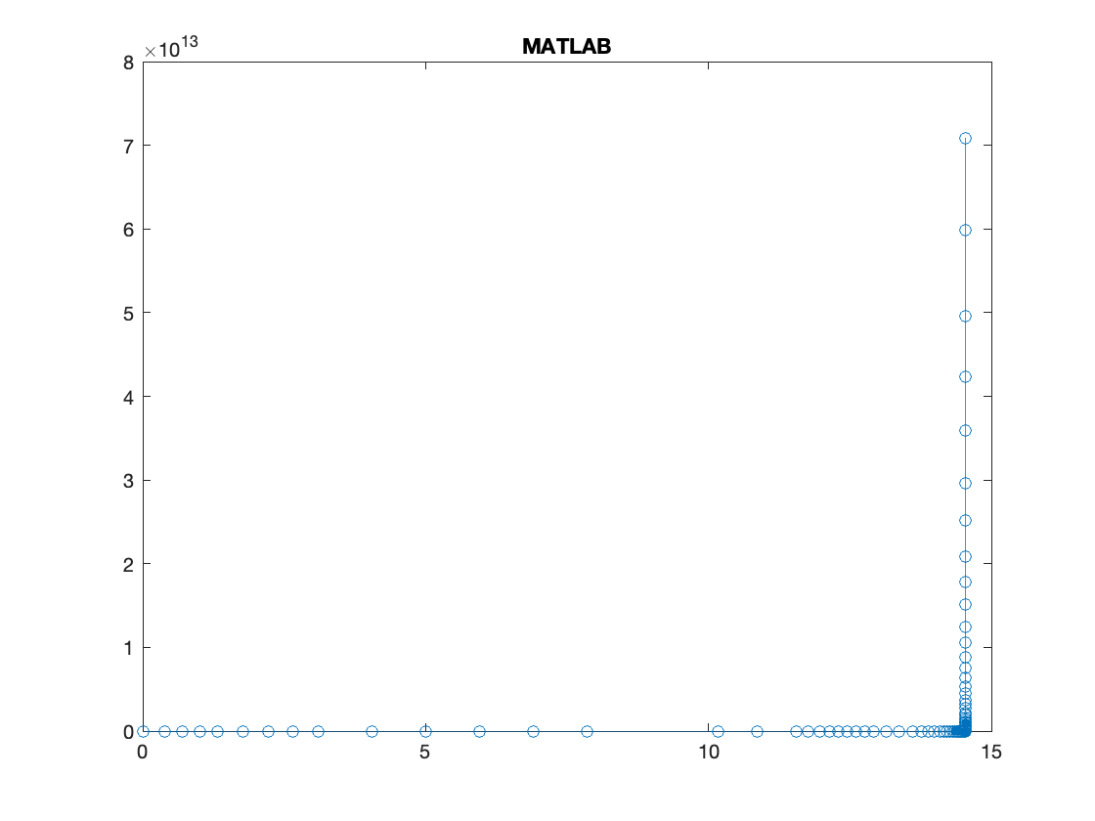
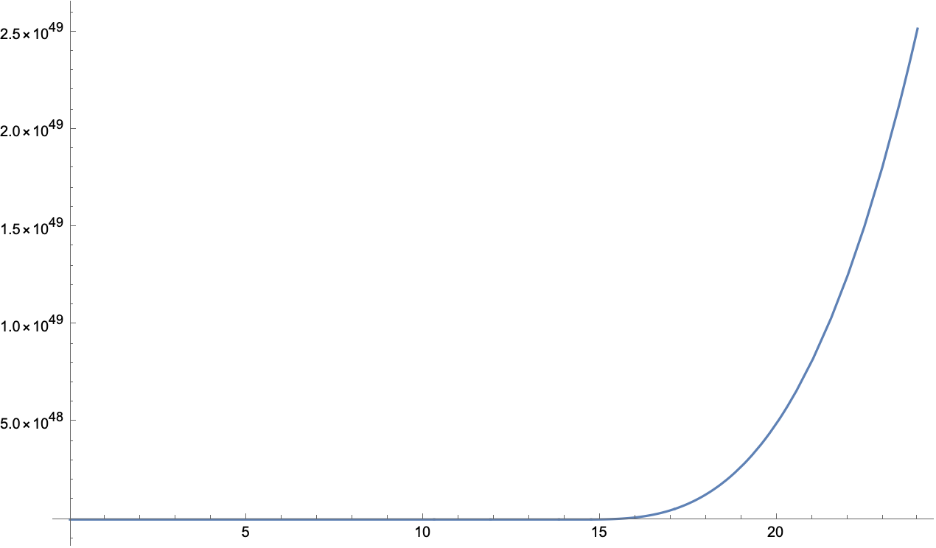
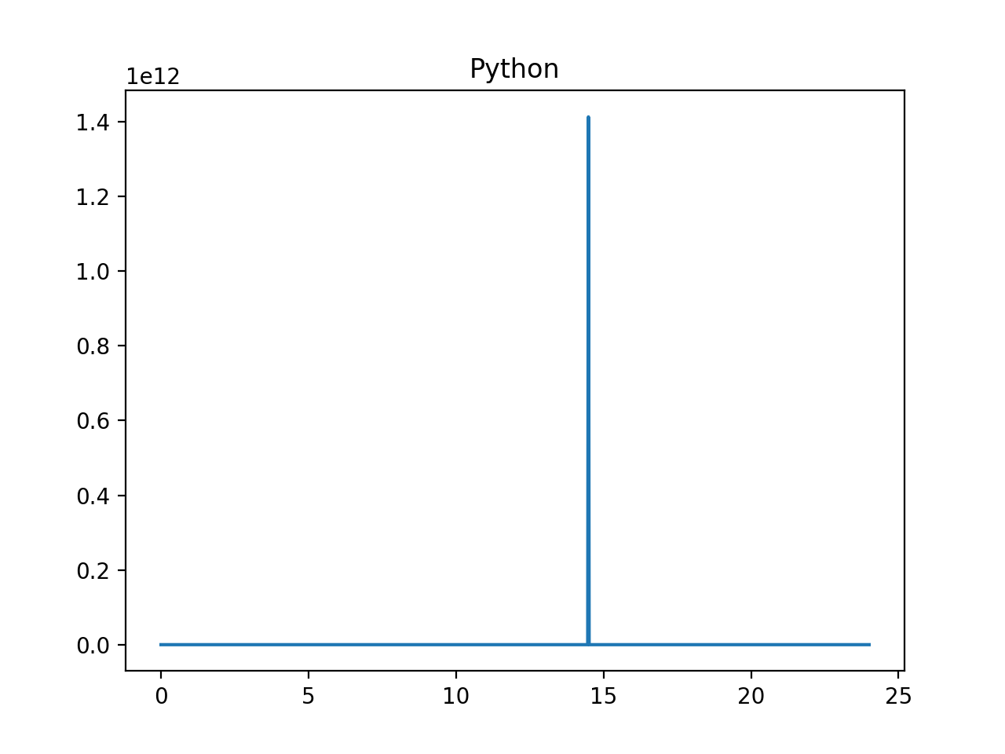
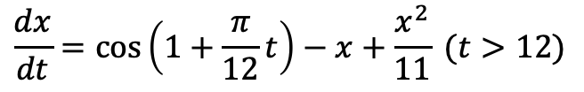
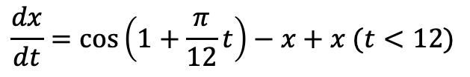
Mathematica
$$\frac{dx}{dt}=\cos\left(1+\frac{π}{12}t\right)−x+x (t<12)$$
$$\frac{dx}{dt}=\cos\left(1+\frac{π}{12}t\right)−x+\frac{x^{2}}{11} (t>12)$$

